Slide 1

UE23CS352B - Object Oriented Analysis and Design
GRASP
Prof. Shridevi A Sawant
Dept. of Computer Science and Engineering
Acknowledgements:
Dr. J. MANNAR MANNAN
Dept. of Computer Science and Engineering

Slide 2

Object Oriented Analysis and Design
Agenda
Introduction to GRASP
Responsibility
Types of Responsibility
References
GRASP Design Principles

Slide 3
Object Oriented Analysis and Design
Introduction - GRASP
Stands for General Responsibility Assignment Software Patterns
GRASP - Consists of guidelines for assigning responsibility to classes and objects in object-oriented design.
GRASP with object-oriented programming classifies problems and their solutions together as patterns. With these problems and solutions well defined, they can be applied in other similar instances.
First published by Craig Larman in 1977, with set of "nine fundamental principles in object design and responsibility”
GRASP is occasionally coupled with other design patterns such as SOLID

Slide 4
Object Oriented Analysis and Design
Responsibility
A contract / obligation that a class / module / component must accomplish
Responsibility can be:
* Accomplished by a single object
* A group of object collaboratively accomplish a responsibility.
Identify the objects and responsibilities from the problem domain, and also identify how objects interact with each other. Helps us in deciding which responsibility should be assigned to which object/class.
Define blueprint for those objects – i.e., class with methods implementing those responsibilities

Slide 5
Object Oriented Analysis and Design
Responsibility contd..
Design of software objects and larger scale components is in terms of responsibilities, roles, and collaborations. - RDD – Responsibility Driven Design
RDD – An abstraction of what they do
UML - A contract or obligation of a classifier
Related to the obligations or behavior of an object in terms of its role
Assigned to classes of objects during object design.
Example: I may declare that “a Sale is responsible for creating SalesLineItems”
The translation of responsibilities into classes and methods is influenced by the granularity of the responsibility

Slide 6
Object Oriented Analysis and Design
Types of Responsibility
Doing:
Doing something itself, such as creating an object or doing a calculation
Initiating action in other objects
Controlling and coordinating activities in other objects
Knowing:
Knowing about private encapsulated data
Knowing about related objects
Knowing about things it can derive or calculate

Slide 7
Object Oriented Analysis and Design
GRASP Design principles
Different patterns/principles used are
Creator
Information expert
Low coupling
Controller
High cohesion
Polymorphism
Indirection
Protected variations
Pure fabrication
Design principle (Larman: “pattern”) – An attempt at a methodical way to do object design

Slide 8
Object Oriented Analysis and Design
Creator
Who creates an Object? Or who should create a new instance of some class?
Assign the responsibility of creating instances of a class to the class that has the most knowledge about when and how to create them
“Container” object creates “contained” objects.
Decide who can be creator based on the object's association and their interaction
Example: Who creates the square object in monopoly game?

Slide 9
Object Oriented Analysis and Design
Creator
Identify Object Creation Scenarios: Determine which classes are responsible for creating instances of other classes within the system.
Delegate Object Creation: Assign responsibility for creating objects to classes that are best suited for the task.
Encapsulate Initialization Logic: Ensure that the classes responsible for creating objects encapsulate the initialization logic within them.
Promote Loose Coupling: Aim to minimize dependencies between classes by decoupling object creation logic from the classes that use the created objects.
Consider Dependency Inversion: When designing classes that create objects, consider using dependency inversion principles to invert dependencies and promote abstraction.

Slide 10
Object Oriented Analysis and Design
Creator
public class OrderService { private final OrderRepository orderRepository; public OrderService(OrderRepository orderRepository) { this.orderRepository = orderRepository; } public void createOrder(Customer customer, List<Product> products) { // Create a new order object Order order = new Order(customer, products); // Save the order to the repository orderRepository.saveOrder(order); } }

Slide 11
Object Oriented Analysis and Design
Creator
In this example, the OrderService class is responsible for creating instances of Order objects.
It encapsulates the initialization logic for creating orders and delegates the task of persisting orders to an OrderRepository class.
By centralizing object creation logic within the OrderService class, we promote encapsulation and loose coupling in the system.

Slide 12
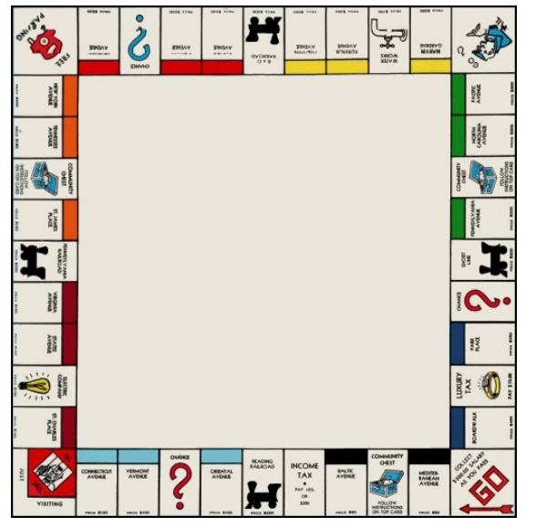
Object Oriented Analysis and Design
Monopoly game

Slide 13
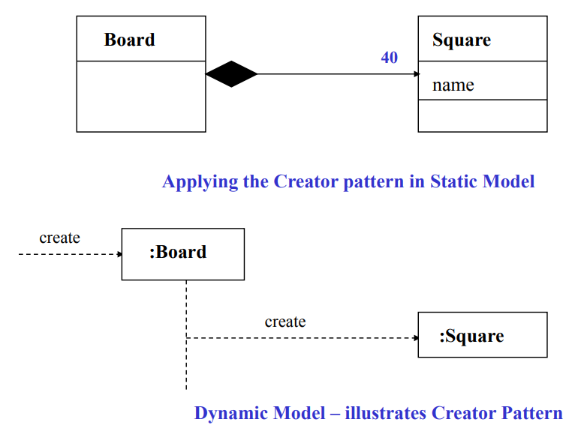
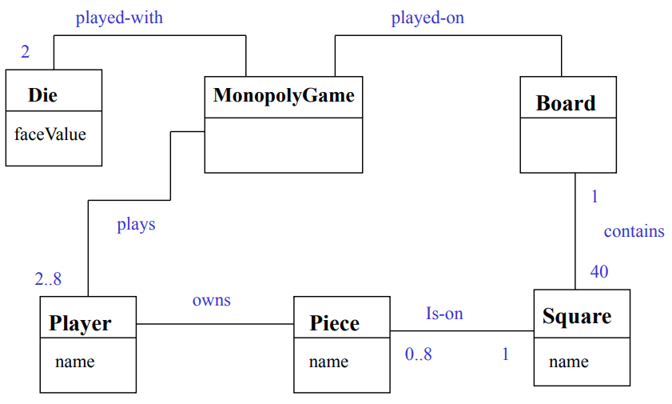
Object Oriented Analysis and Design
Creator – Monopoly example

Slide 14
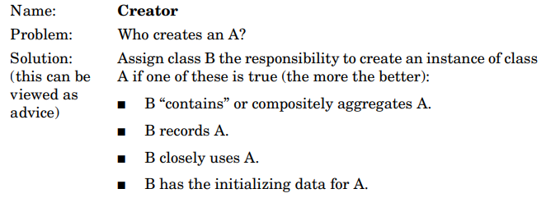
Object Oriented Analysis and Design
Creator
Start with domain model.
Since a Sale contains SalesLineItem objects, it should be responsible according to the Creator pattern
Note: There is a related design pattern called Factory pattern for more complex creation situations

Slide 15
Object Oriented Analysis and Design
Information Expert
Problem: What is a basic principle by which to assign responsibilities to objects?
Solution: Assign a responsibility to the class that has the information needed to fulfill it.
“objects do things related to the information they have”
Information necessary may be spread across several classes => objects interact via messages

Slide 16
Object Oriented Analysis and Design
Information Expert
They have all the information needed to perform operations, or in some cases they collaborate with others to fulfill their responsibilities.
Example: (from POS system) Who should be responsible for knowing the grand total of a sale?
Start with domain model and look for associations with Sale
What information is necessary to calculate grand total and which objects have the information?

Slide 17
Object Oriented Analysis and Design
Information Expert - Summary
Design Class | Responsibility
Sale | knows sale total
SalesLineItem | knows line-item subtotal
ProductDescription | knows product price

Slide 18
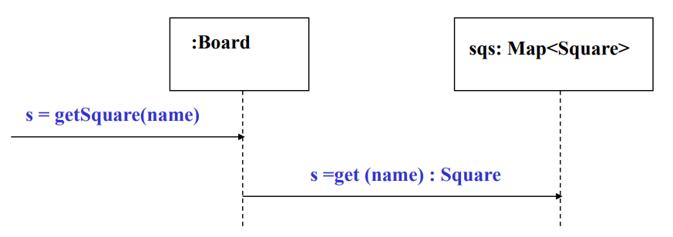
Object Oriented Analysis and Design
Information Expert –Monopoly game
The player Marker needs to find the square to which it is to move and the options pertaining to that square.
The Board aggregates all of the Squares, so the Board has the Information needed to fulfill this responsibility.
Make board information expert

Slide 19
Object Oriented Analysis and Design
Information Expert –Shopping Cart
public class ShoppingCart {
private List<Item> items = new ArrayList<>();
public void addItem(Item item) {
items.add(item);
}
public double calculateTotalPrice() {
double totalPrice = 0;
for (Item item : items) {
totalPrice += item.getPrice();
}
return totalPrice;
}
}
public class Item {
private String name;
private double price;
public Item(String name, double price) {
this.name = name;
this.price = price;
}
public double getPrice() {
return price;
}
}

Slide 20
Object Oriented Analysis and Design
In this example, the “Information Expert” principle is applied by assigning responsibility for calculating the total price of items in the shopping cart to the ShoppingCart class.
Since the ShoppingCart class has access to the list of items and their prices, it is the most suitable class to perform this calculation.
The Item class, on the other hand, encapsulates information about individual items, such as their name and price.
By delegating responsibilities based on expertise and information, we promote high cohesion and encapsulation in the design.

Slide 21
Object Oriented Analysis and Design
Low Coupling
Coupling – Coupling describes the degree of dependency between classes or modules. It indicates how closely connected different classes or modules are, and how much they rely on each other. There are two main types of coupling
Tight Coupling: High dependency between classes. Changes in one class often require changes in the coupled class. Tight coupling occurs when a class is highly dependent on the specifics of another class. This often happens when one class creates an instance of another class and directly accesses its methods and fields.
Loose Coupling: Low dependency between classes. Classes interact through well-defined interfaces, reducing the impact of changes. Loose coupling occurs when classes are less dependent on the specifics of other classes. This can be achieved by using interfaces, abstract classes, or dependency injection, allowing classes to interact without knowing the implementation details of each other.

Slide 22
Object Oriented Analysis and Design
Low Coupling
Definition:
Name: Low Coupling
Problem: How to support low dependency, low change impact, increased reuse?
Solution: Assign a responsibility so coupling is low.
Minimizes the dependency hence making system maintainable, efficient and code reusable
Example: Inheritance, Composition, aggregation, association
Low coupling is an evaluative pattern that dictates how to assign responsibilities to support
lower dependency between the classes
change in one class having a lower impact on other classes
higher reuse potential

Slide 23
Object Oriented Analysis and Design
Low Coupling contd..
A class with high coupling leads to problems:
Changes in related classes force local changes
Harder to understand in isolation
Harder to reuse
Low Coupling – How can we reduce the impact of change in depended elements on dependent elements? Assign responsibilities so that coupling remains low.
Two elements are coupled, if – One element has aggregation/composition association with another element. – One element implements/extends other element

Slide 24
Object Oriented Analysis and Design
Low Coupling contd..
Assign a responsibility so that coupling remains low.
A class, for example, with high (or strong) coupling relies on many other classes. Such classes may be undesirable; some suffer from the following problems:
Forced local changes because of changes in related classes.
Harder to understand in isolation.
Harder to reuse because its use requires the additional presence of the classes on which it is dependent.

Slide 25
Object Oriented Analysis and Design
Low Coupling contd..
Good to know below are some key points about low coupling
Low dependencies between “artifacts” (classes, modules, components).
There shouldn’t be too much of dependency between the modules, even if there is a dependency it should be via the interfaces and should be minimal.
Avoid tight-coupling for collaboration between two classes (if one class wants to call the logic of a second class, then first class needs an object of second class it means the first class creates an object of the second class).
Strive for loosely coupled design between objects that interact.
Inversion Of Control (IoC) / Dependency Injection (DI) - With DI objects are given their dependencies at creation time by some third party (i.e. Java EE CDI, Spring DI…) that coordinates each object in the system. Objects aren’t expected to create or obtain their dependencies—dependencies are injected into the objects that need them. The key benefit of DI—loose coupling.

Slide 26
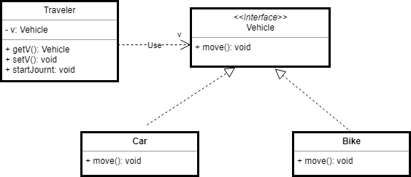
Object Oriented Analysis and Design
Low Coupling contd..

Slide 27
Object Oriented Analysis and Design
Low Coupling contd..
// Vehicle interface to allow loose coupling implementation
interface Vehicle {
void move();
}
// Car class implements Vehicle interface
class Car implements Vehicle {
@Override
public void move() {
System.out.println("Car is moving");
}
}
// Bike class implements Vehicle interface
class Bike implements Vehicle {
@Override
public void move() {
System.out.println("Bike is moving");
}
}
Now create a Traveler class which holds the reference to the Vehicle interface.
class Traveler {
private Vehicle v;
public Vehicle getV() {
return v;
}
public void setV(Vehicle v) {
this.v = v;
}
public void startJourney() {
v.move();
}
}

Slide 28
Object Oriented Analysis and Design
Low Coupling contd..
Test class for loose coupling example - Traveler is an example of loose coupling
public static void main(String[] args) {
Traveler traveler = new Traveler();
traveler.setV(new Car()); // Inject Car dependency
traveler.startJourney(); // start journey by Car
traveler.setV(new Bike()); // Inject Bike dependency
traveler.startJourney(); // Start journey by Bike
}

Slide 29
Object Oriented Analysis and Design
Low Coupling contd..
Example 2 (from POS system): Consider Payment, Register, Sale
To create a Payment and associate it with a Sale, who is responsible?
Register “records” a Payment. So, Register is the creator
Register creates Payment p then sends p to a Sale => coupling of Register class to Payment class

Slide 30
Object Oriented Analysis and Design
Low Coupling contd..
Alternate approach: Register requests Sale to create the Payment
Note:
In both cases, Sale needs to know about a Payment
However, a Register needs to know about a Payment in first but not in second
Second approach has lower coupling

Slide 31
Object Oriented Analysis and Design
Low Coupling – More in terms of Java
Low coupling is an evaluative principle, i.e., keep it in mind when evaluating designs
Examples of coupling in Java (think “dependencies”):
TypeX has an attribute of TypeY
TypeX calls on services of a TypeY object
TypeX has a method that references an instance of TypeY
TypeX is a subclass of TypeY
TypeY is an interface and TypeX implements the interface
Note: subclassing => high coupling

Slide 32
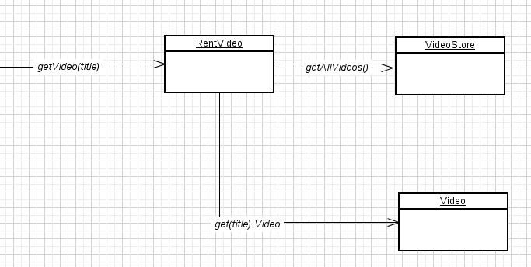
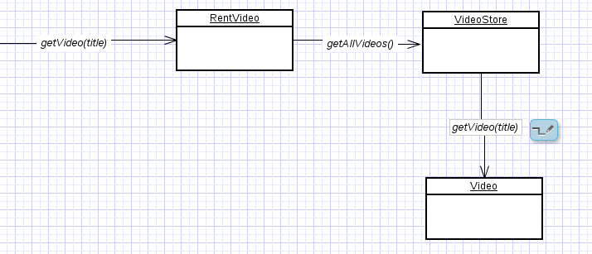
Object Oriented Analysis and Design
Example: Low Coupling
High Coupling
here class RentVideo knows about both VideoStore and Video objects. Rent is depending on both the classes.
Low Coupling
VideoStore and Video class are coupled, and Rent is coupled with VideoStore. Thus, providing low coupling.

Slide 33
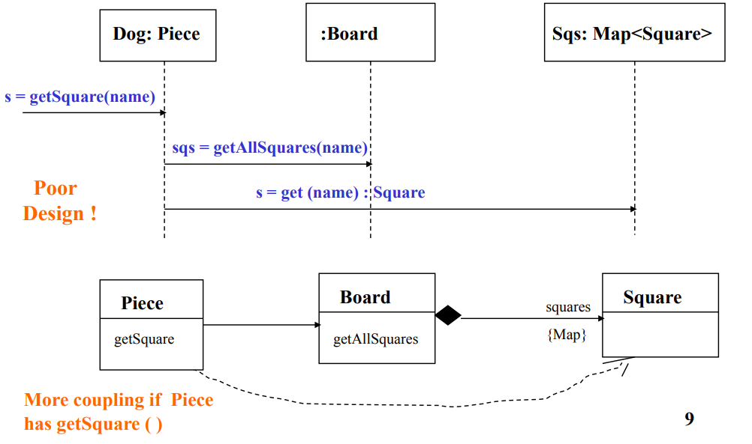
Object Oriented Analysis and Design
Low Coupling – Monopoly example
Alternate Design: Bad solution

Slide 34
Object Oriented Analysis and Design
High cohesion
Cohesion - A measure of how strongly related and focused the responsibilities of an element (class, subsystem, etc.)
Definition:
Name: High Cohesion
Problem: How to keep complexity manageable, understandable and support low coupling?
Solution: Assign the responsibility so that cohesion remains high.
Problems from low cohesion (does many unrelated things or does too much work):
Hard to understand/comprehend
Hard to reuse
Hard to maintain
Brittle – easily affected by change

Slide 35
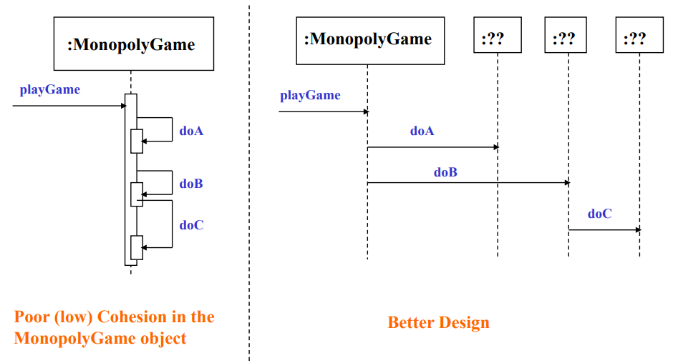
Object Oriented Analysis and Design
High Cohesion - Monopoly example

Slide 36
Object Oriented Analysis and Design
MCQ
1. GRASP stands for:
A) General Responsibility Assignment Software Patterns B) General Rules for Application Software Programming C) Generic Reusable Architecture System Principles D) Global Responsibility Allocation Software Process
2. GRASP mainly provides guidelines for:
A) Database normalization B) Assigning responsibilities to classes and objects C) Writing algorithms D) Network communication

Slide 37
Object Oriented Analysis and Design
MCQ
3. GRASP contains how many fundamental principles of object design?
A) Five B) Seven C) Nine D) Twelve
4. In object-oriented design, responsibility refers to:
A) Data storage only B) Database queries C) Compilation rules D) A contract or obligation of a class or component

Slide 38
Object Oriented Analysis and Design
MCQ
5. Loose coupling means:
A) High dependency between classes B) No interaction between classes C) Low dependency between classes D) Only inheritance relationships
6. Cohesion measures:
A) Database connections B) Relationship between modules C) How strongly related responsibilities of a class are D) Execution speed

Slide 39
Object Oriented Analysis and Design
MCQ SOLUTION
1.A
2.B
3.C
4.D
5.C
6.C

Slide 40
Object Oriented Analysis and Design
References
Source Code Examples
Ad-hoc, Inclusion, Parametric & Coercion Polymorphisms – GeeksforGeeks
Larman - Monopoly Game.pdf - THE MONOPOLY GAME SYSTEM • The software version of the game will run as a simulation • One person will start the game and | Course Hero
http://www.kamilgrzybek.com/design/grasp-explained/

Slide 41
THANK YOU
Prof. Shridevi A Sawant
Computer Science and Engineering

